Slide 1
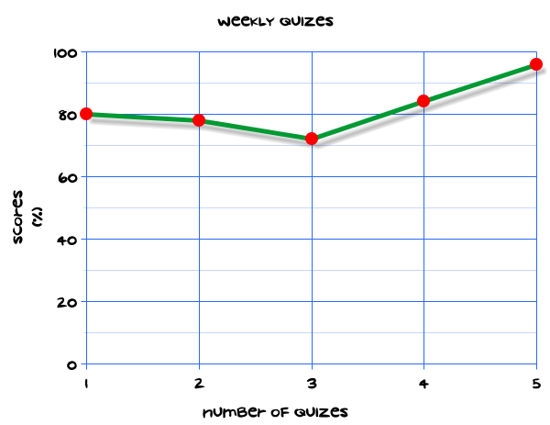
My Statistics Interactive Notebook
Name
Class
Teacher
Term 1 Semester 1
1

Slide 2
Create your own front page
It needs to contain the following –
My number interactive notebook
Name
Class
Teachers Name
Semester 1 Term 1
Page number 1

Slide 3
Contents
Glossary or Formula Page
Page
Date
Description
2
3

Slide 4
Tasks
24
7
30
Essential Question
Questions
Notes
Summary
4
5

Slide 5
24
7
30
Date
Title
EQ –

Slide 6
24
7
30
Date
Introduction to probability
EQ – Describe how a sample space is used to estimate probability

Slide 7
24
7
30
Date
Introduction to probability
EQ – Describe how a sample space is used to estimate probability
The probability of an event is between 0 and 1. it can be written as words, a fraction, decimal or percentage.

Slide 8
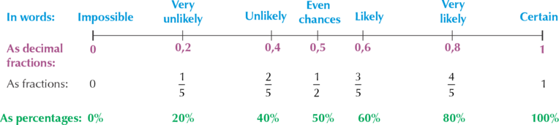
24
7
30
Date
Introduction to probability
EQ – Describe how a sample space is used to estimate probability
How can I write probability?
The probability of an event is between 0 and 1. it can be written as words, a fraction, decimal or percentage.
What is the probability scale?

Slide 9
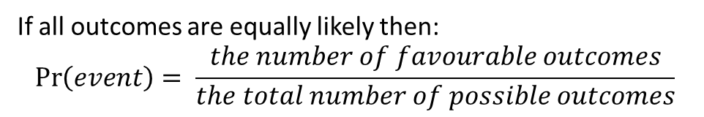
24
7
30
Date
Introduction to probability
EQ – Describe how a sample space is used to estimate probability
How can I write probability?
The probability of an event is between 0 and 1. It can be written as words, a fraction, decimal or percentage.
What is the probability scale?
How do I calculate the probability of an event?
If all outcomes are equally likely then:
$$\operatorname{Pr}\left(event\right)= \frac{the number of favourable outcomes}{the total number of possible outcomes}$$

Slide 10
24
7
30
Date
Introduction to probability
EQ – Describe how a sample space is used to estimate probability
How can I write probability?
The probability of an event is between 0 and 1. It can be written as words, a fraction, decimal or percentage.
What is the probability scale?
How do I calculate the probability of an event?
If all outcomes are equally likely then:
$$\operatorname{Pr}\left(event\right)= \frac{the number of favourable outcomes}{the total number of possible outcomes}$$
What is a sample space?
The sample space is a list of all possible outcomes. It may contain numbers or qualities depending on the data set.

Slide 11

24
7
30
Date
Introduction to probability
EQ – Describe how a sample space is used to estimate probability
Examples:
The sample space for rolling a six sided die is:
$$S= \left\{1, 2, 3, 4, 5, 6\right\}$$

Slide 12

24
7
30
Date
Introduction to probability
EQ – Describe how a sample space is used to estimate probability
Examples:
The sample space for rolling a six sided die is:
$$S= \left\{1, 2, 3, 4, 5, 6\right\}$$
$$\operatorname{Pr}\left(rolling a 5\right)= \frac{1}{6}$$

Slide 13
24
7
30
Date
Introduction to probability
EQ – Describe how a sample space is used to estimate probability
Examples:
The sample space for rolling a six sided die is:
$$S= \left\{1, 2, 3, 4, 5, 6\right\}$$
One side is a 5
$$\operatorname{Pr}\left(rolling a 5\right)= \frac{1}{6}$$
probability
event
6 possible outcomes

Slide 14
24
7
30
Date
Introduction to probability
EQ – Describe how a sample space is used to estimate probability
Examples:
The sample space for rolling a six sided die is:
$$S= \left\{1, 2, 3, 4, 5, 6\right\}$$
One side is a 5
$$\operatorname{Pr}\left(rolling a 5\right)= \frac{1}{6}$$
probability
event
6 possible outcomes
A bag contains 4 coloured balls: 1 red, 1 blue, 1 green, 1 yellow.

Slide 15

24
7
30
Date
Introduction to probability
EQ – Describe how a sample space is used to estimate probability
Examples:
The sample space for rolling a six sided die is:
$$S= \left\{1, 2, 3, 4, 5, 6\right\}$$
One side is a 5
$$\operatorname{Pr}\left(rolling a 5\right)= \frac{1}{6}$$
probability
event
6 possible outcomes
A bag contains 4 coloured balls: 1 red, 1 blue, 1 green, 1 yellow.
$$S= \left\{red, blue, green, yellow\right\}$$

Slide 16

24
7
30
Date
Introduction to probability
EQ – Describe how a sample space is used to estimate probability
Examples:
The sample space for rolling a six sided die is:
$$S= \left\{1, 2, 3, 4, 5, 6\right\}$$
One side is a 5
$$\operatorname{Pr}\left(rolling a 5\right)= \frac{1}{6}$$
probability
event
6 possible outcomes
A bag contains 4 coloured balls: 1 red, 1 blue, 1 green, 1 yellow.
$$S= \left\{red, blue, green, yellow\right\}$$
$$\operatorname{Pr}\left(choosing a blue ball\right)= \frac{1}{4}$$

Slide 17
24
7
30
Date
Introduction to probability
EQ – Describe how a sample space is used to estimate probability
Examples:
The sample space for rolling a six sided die is:
$$S= \left\{1, 2, 3, 4, 5, 6\right\}$$
One side is a 5
$$\operatorname{Pr}\left(rolling a 5\right)= \frac{1}{6}$$
probability
event
6 possible outcomes
A bag contains 4 coloured balls: 1 red, 1 blue, 1 green, 1 yellow.
$$S= \left\{red, blue, green, yellow\right\}$$
One ball is blue
probability
$$\operatorname{Pr}\left(choosing a blue ball\right)= \frac{1}{4}$$
event
4 possible outcomes

Slide 18
Task
Turn to page 482 in your text book.
Complete questions 2 – 8
Extension:
Page 484, Q13, 14 and 15.

Slide 19
Notes Review
24, 7 ,30
Date
Title
Essential question
Notes complete
Notes complete with colour and diagrams
Questions completed
Contents page filled in
Formula page filled in

Slide 20
Homework
Review your notes and write a summary answering the essential question.

